Slide 1
Course Logistics and Introduction
CS771: Introduction to Machine Learning

Slide 2
Course Logistics
Timing and Venue: Mon/Thur 6:00-7:15pm, L-20
Course website: https://tinyurl.com/cs771-a24 (slides, readings, etc)
Online discussion/QA: Piazza (https://tinyurl.com/cs771-a24-piazzasignup)
Instructor’s contact email: piyush@cse.iitk.ac.in, office: RM-502 (CSE dept)
Prefix email subject with CS771, else might get ignored
Use of Piazza is encouraged for course-related matters (also has private messaging)
Office hours: By appointment
TAs: Team of 20 TAs. Their contact and office hours details shared soon
Unofficial auditors are welcome. However, can’t participate in exams/quizzes
Can attempt homeworks, quizzes, exams on their own. Won’t be graded

Slide 3

Workload and Grading Policy
Quizzes will be closed-book. For exams, one A4 size cheat-sheet will be allowed
4 quizzes: 20%
2 homeworks/mini-projects: 30%
Writeups must be prepared in PDF using the provided LaTeX template
Knowledge of Python programming is assumed
To be done in groups of 5 students. Form your groups NOW
Mid-sem exam: 20%
End-sem exam: 30%
Quiz dates (tentative): Aug 13, Sept 3, Oct 1, Oct 22 (duration: 30 mins)
Quiz timing and venue: will be announced closed to the quiz date
HW/mini-project dates (tentative): Aug 19, Oct 3 (roughly 3 work-weeks given)
Mid-sem and end-sem exam dates: As per DOAA announcements

Slide 4
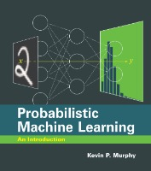
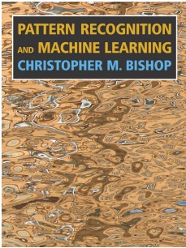
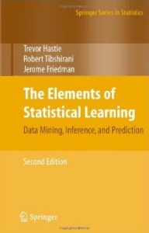
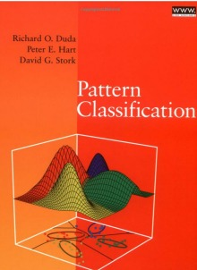

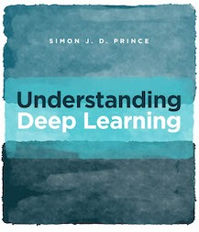
Textbook and References
Many excellent texts but none “required”. Some include:
See the course website for links and other relevant texts and references
Different books might vary in terms of
Set of topics covered
Flavor (e.g., classical statistics, deep learning, probabilistic/Bayesian, theory)
Terminology and notation (beware of this especially)
For each topic in the course, we will provide you recommended readings

Slide 5
Course Goals
Introduction to the foundations of machine learning (ML)
Focus on developing the ability to
Understand the underlying principles (and maths ☺) behind ML models and algos
Understand how to implement and evaluate them
Understand/develop intuition on choosing the right ML model/algo for your problem
(Hopefully) inspire you to work on and learn more about ML
Not an intro to popular software frameworks and libraries, such as scikit-learn, PyTorch, Tensorflow, etc
However, you are encouraged to explore these as the course progresses
See the course website for links and other relevant texts and references
Different books might vary in terms of
Set of topics covered
Flavor (e.g., classical statistics, deep learning, probabilistic/Bayesian, theory)
Terminology and notation (beware of this especially)
We will provide you the reading material from the relevant sources

Slide 6
Expectations from you
Attend classes regularly (even though we have no attendance policy)
Please make yourself acquainted with the maths required for the course
We will provide some refresher slides and reference material
Some of the maths will be introduced as and when it is needed
Please ensure that you understand the maths on the slides
We won’t do all the derivations on the slides
In class, our focus will be on key steps and intuition
If not obvious, you should try to work out the detailed steps at home (will be good practice for quizzes and exams) on your own or with classmates
If things are unclear, please do reach out to us (e.g., on Piazza or office hours)

Slide 7
What Is Machine Learning?

Slide 8
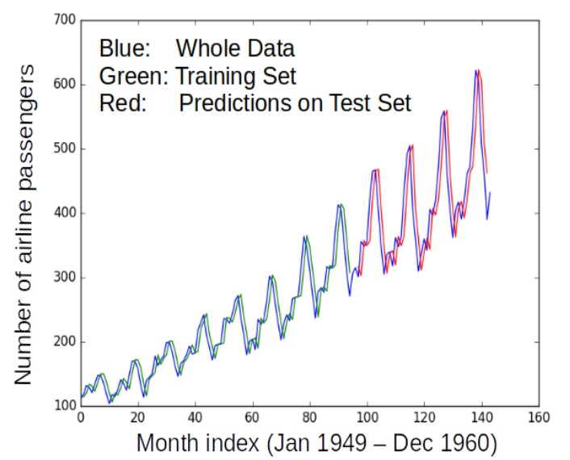
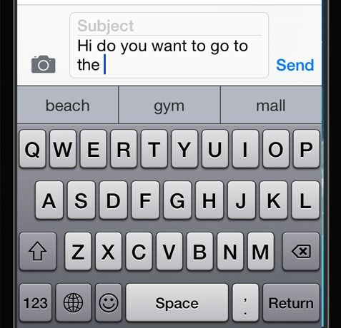
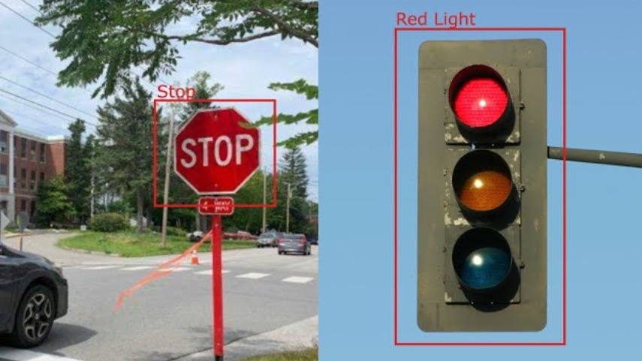
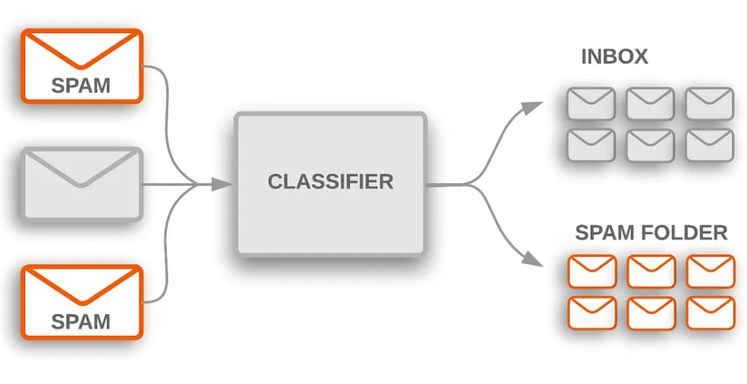
Machine Learning (ML)
Designing algorithms that ingest data and learn a model of the data
The learned model can be used to
Detect patterns/structures/themes/trends etc. in the data
Make predictions about future data and make decisions
Modern ML algorithms are heavily “data-driven”
No need to pre-define all the rules by humans (infeasible/impossible anyway)
The rules are not “static”; can adapt as the ML algo ingests more and more data
Next word prediction (key task in large-language models like ChatGPT)

Slide 9

Where Should We Use ML?
Handwritten digit recognition: Not too complex but still reasonably complex that an ML approach is desirable
When the learning problem is very complex, e.g.,
Enumerating all rules is infeasible or too time-consuming
Rules might evolve with time
In such cases, hard-coding the rules in a computer program may not work
Difficult to define and code all possible rules
Difficult to update the program if rules evolve
ML replaces the idea of humans writing code by humans supplying data
The ML algorithm automatically learns the model (the rules) from the supplied data
The model can evolve with more and more data

Slide 10
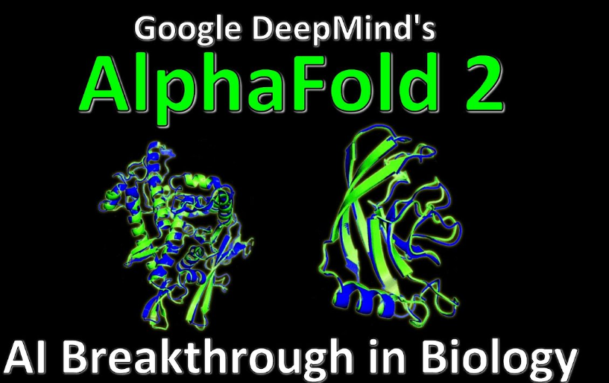
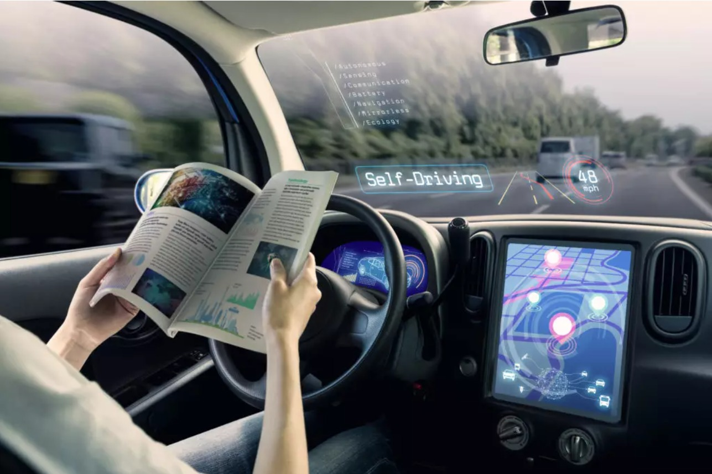
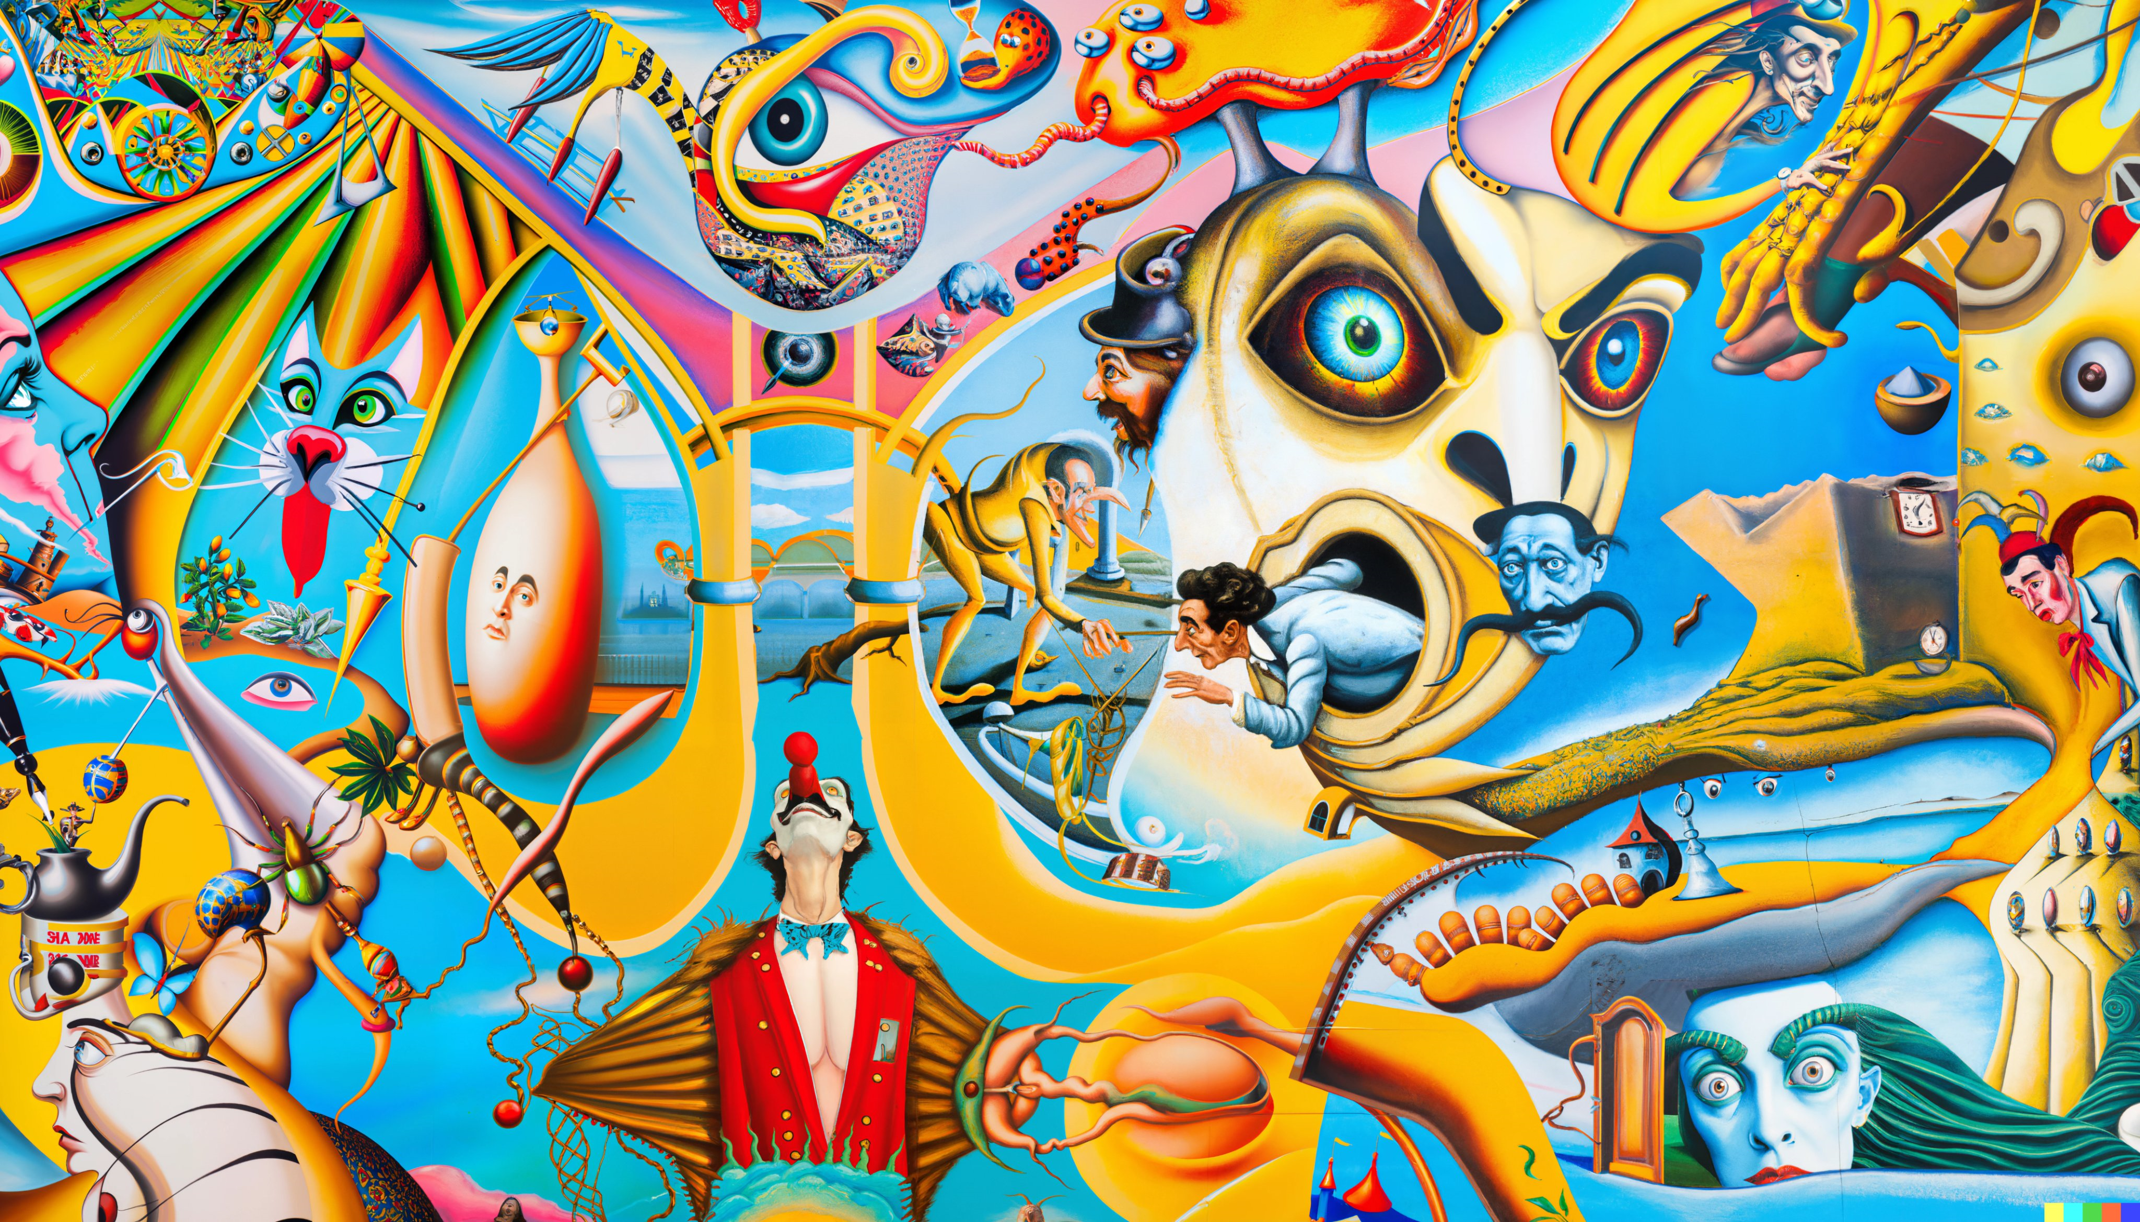
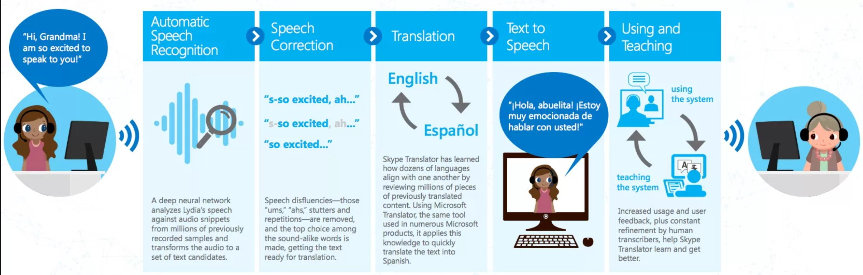

ML: Some Success Stories
Protein Structure Prediction
Autonomous Driving
AI Generated Digital Art (Dall E 2)
Real-time Speech Translation
Conversational Systems
Digital art pic credit: David Schnurr

Slide 11
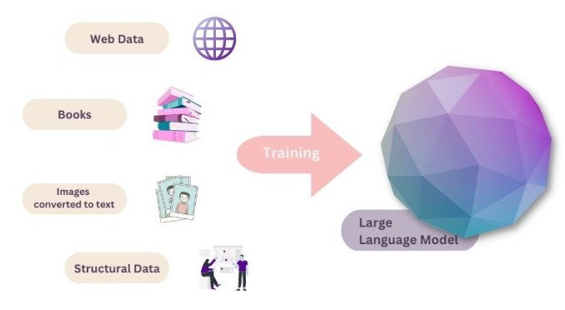

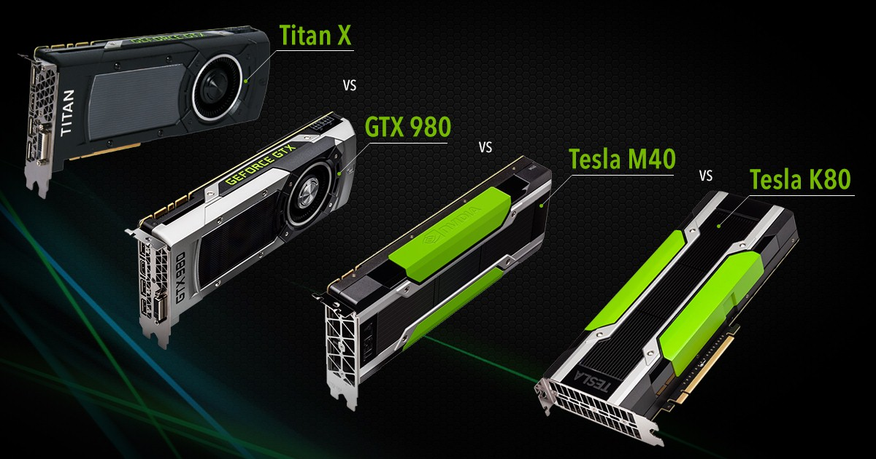
Key Enablers for Modern ML
Availability of large amounts of data to train ML models
Increased computing power (e.g., GPUs)

Slide 12
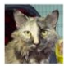
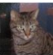
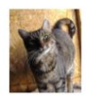
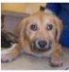
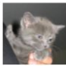
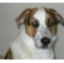
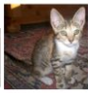
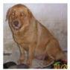
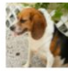
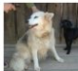
ML: A Simple Illustration
ML enables intelligent systems to be data-driven rather than rule-driven
How: By supplying training data and building statistical models of data
Pictorial illustration of an ML model for binary classification:
A Linear Classifier (the statistical model)

Slide 13
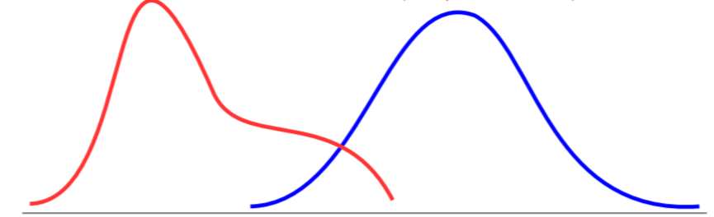
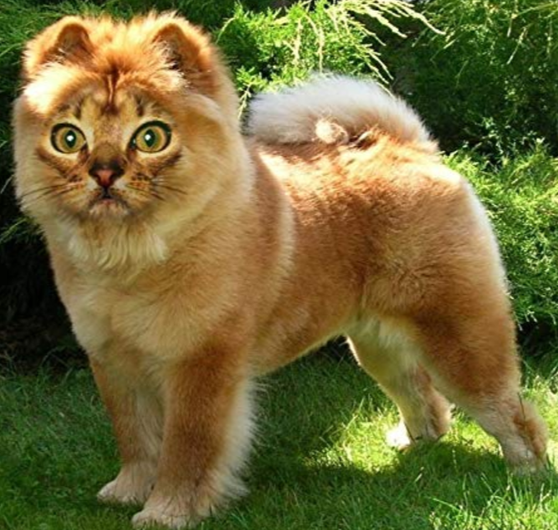
ML: A Simple Illustration
ML enables intelligent systems to be data-driven rather than rule-driven
How: By supplying training data and building statistical models of data
Pictorial illustration of an ML model for binary classification:
A Probabilistic Classifier (the statistical model)
P(“cat”|image)
P(“dog”|image)

Slide 14
ML: The Exam Analogy
It’s the performance on the D-day which matters
In an exam, our success is measured based on how well we did on the questions in the test (not on the questions we practiced on)
Likewise, in ML, success of the learned model is measured based on how well it predicts/fits the future test data (not the training data)
In Machine Learning, generalization performance
on the test data matters
(we should not “overfit” on training data)

Slide 15
A Loose Taxonomy of ML
“Labeled” means, during training, for each input, the corresponding output is available (i.e., the machine learner is explicitly told that a cat image is of a cat)
Learning using labeled data
Learning using unlabeled data
Some examples of
supervised learning problems
Classification
Regression
Ranking
Supervised
Learning
Unsupervised
Learning
Some examples of
unsupervised learning problems
Clustering
Dimensionality Reduction
Unsupervised Probability Density Estimation
Generative Models (e.g., ChatGPT)
Machine Learning
Many other specialized flavors of ML also exist,
some of which include
Semi-supervised Learning
Self-supervised Learning (very popular these days)
Active Learning
Transfer Learning
Multitask Learning
Zero-Shot/Few-Shot Learning
Continual learning
RL doesn’t use “labeled” or
“unlabeled” data in the traditional sense! In RL, an agent learns via
its interactions with an environment
Reinforcement Learning

Slide 16
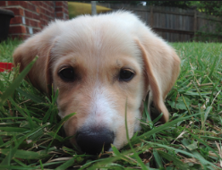
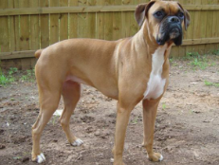
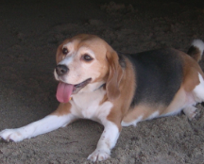
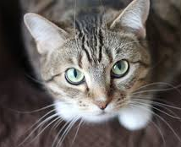


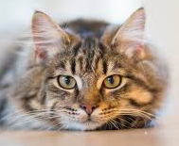

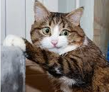
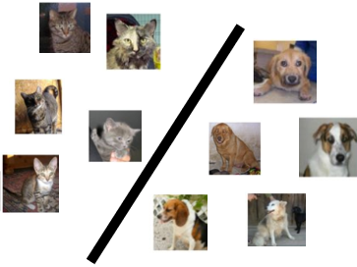
A Typical Supervised Learning Workflow
Note: This example is for the problem of binary classification, a supervised learning problem
Labeled
Training
Data
“dog”
“dog”
“dog”
“dog”
“dog”
Is feature extraction done “manually” as a pre-processing step before the ML algo starts working? Can’t we “automate” this part? Can’t we “learn” good features directly from raw inputs?
“cat”
“dog”
“cat”
“Feature”
Extraction
“cat”
ML Algorithm
(outputs a “model”)
“cat”
“cat”
“cat”
Feature extraction converts raw inputs to a numeric representation that the ML algo can understand and work with. More on feature extraction later.
Predicted Label
(cat/dog)
Test
Image
“Feature”
Extraction
Indeed. Deep Learning algos do precisely that!
(feature + model learning). More on Deep Learning later
Cat vs Dog
Prediction model
https://www.pinclipart.com/, http://www.pngtree.com

Slide 17
A Typical Unsupervised Learning Workflow
Note: This example is for the problem of data clustering, an unsupervised learning problem
Unlabeled
Data
Yes. In this example, given a new “test” cat/dog image, we can assign it to the cluster with closer centroid
“Feature”
Extraction
ML Algorithm
(outputs a clustering)
Does unsupervised learning also have a test phase? That is, can we also predict the cluster of a new test input?
https://www.pinclipart.com/, http://www.pngtree.com

Slide 18
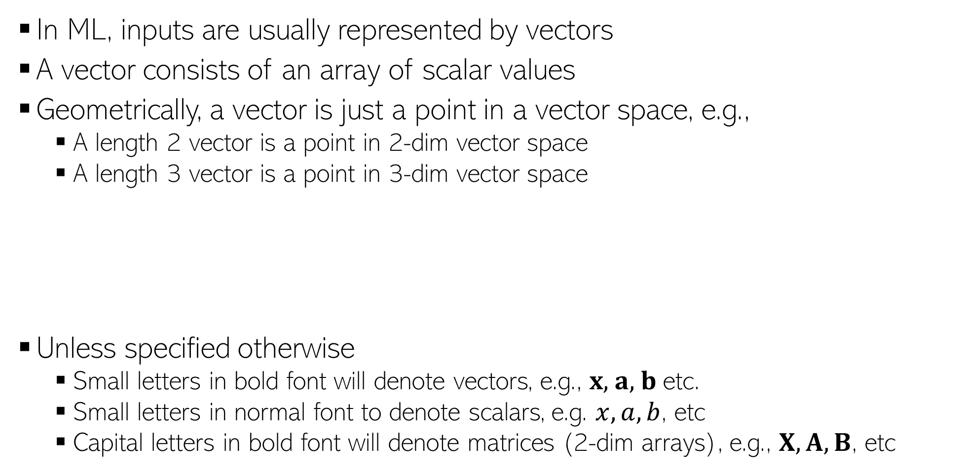
Notation and Convention
In ML, inputs are usually represented by vectors
A vector consists of an array of scalar values
Geometrically, a vector is just a point in a vector space, e.g.,
A length 2 vector is a point in 2-dim vector space
A length 3 vector is a point in 3-dim vector space
Unless specified otherwise
Small letters in bold font will denote vectors, e.g., $x$, $a$, $b$ etc.
Small letters in normal font to denote scalars, e.g. $x, a, b$, etc
Capital letters in bold font will denote matrices (2-dim arrays), e.g., $X, A, B$, etc
0.5 | 0.3 | 0.6 | 0.1 | 0.2 | 0.5 | 0.9 | 0.2 | 0.1 | 0.5
Likewise for higher dimensions, even though harder to visualize
(0.5,0.3)
(0.5,0.3,0.6)
0.5 | 0.3 | 0.6
0.5 | 0.3

Slide 19
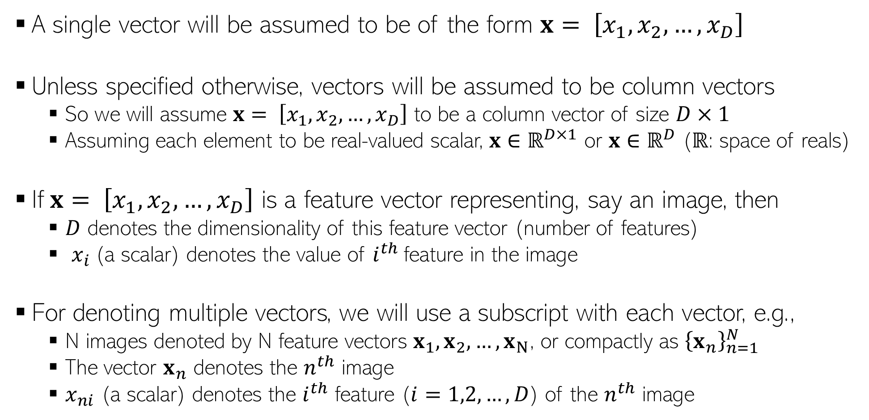
Notation and Convention
A single vector will be assumed to be of the form $x= \left[x_{1},x_{2},…,x_{D}\right]$
Unless specified otherwise, vectors will be assumed to be column vectors
So we will assume $x= \left[x_{1},x_{2},…,x_{D}\right]$ to be a column vector of size $D×1$
Assuming each element to be real-valued scalar, $x$ $∈ℝ^{D×1}$ or $x$ $∈ℝ^{D}$ ($ℝ$: space of reals)
If$x= \left[x_{1},x_{2},…,x_{D}\right]$ is a feature vector representing, say an image, then
$D$ denotes the dimensionality of this feature vector (number of features)
$x_{i}$(a scalar) denotes the value of $i^{th}$feature in the image
For denoting multiple vectors, we will use a subscript with each vector, e.g.,
N images denoted by N feature vectors $x_{1}, x_{2},…,x_{N}$, or compactly as ${\left\{x_{n}\right\}}_{n=1}^{N}$
The vector $x_{n}$ denotes the $n^{th}$ image
$x_{ni}$ (a scalar) denotes the $i^{th}$ feature ($i=1,2,…,D$) of the $n^{th}$ image

Slide 20
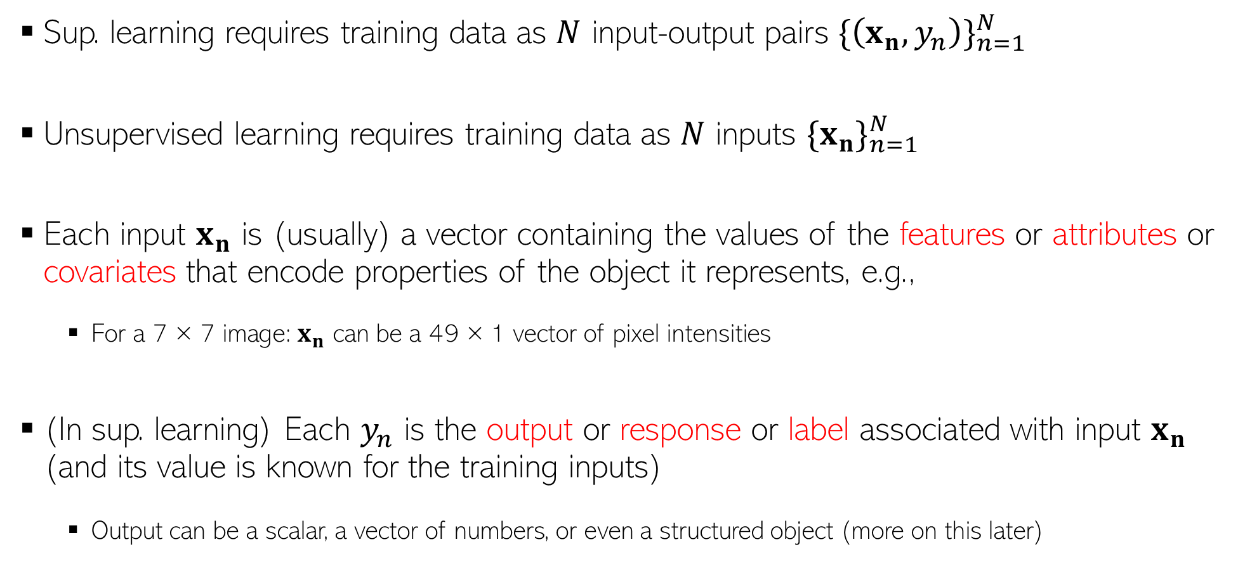
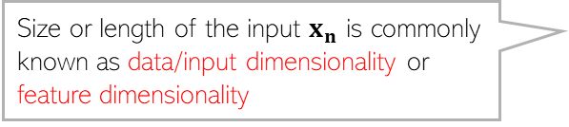
Notation and Convention
Sup. learning requires training data as $N$ input-output pairs ${\{\left(x_{n},y_{n}\right)\}}_{n=1}^{N}$
Unsupervised learning requires training data as $N$ inputs ${\{x_{n}\}}_{n=1}^{N}$
Each input $x_{n}$ is (usually) a vector containing the values of the features or attributes or covariates that encode properties of the object it represents, e.g.,
For a 7 × 7 image: $x_{n}$ can be a 49 × 1 vector of pixel intensities
(In sup. learning) Each $y_{n}$ is the output or response or label associated with input $x_{n}$ (and its value is known for the training inputs)
Output can be a scalar, a vector of numbers, or even a structured object (more on this later)
RL and other flavors of ML problems also use similar notation
Size or length of the input $x_{n}$ is commonly known as data/input dimensionality or feature dimensionality

Slide 21
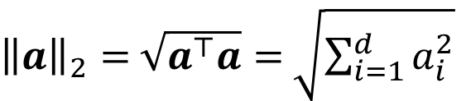
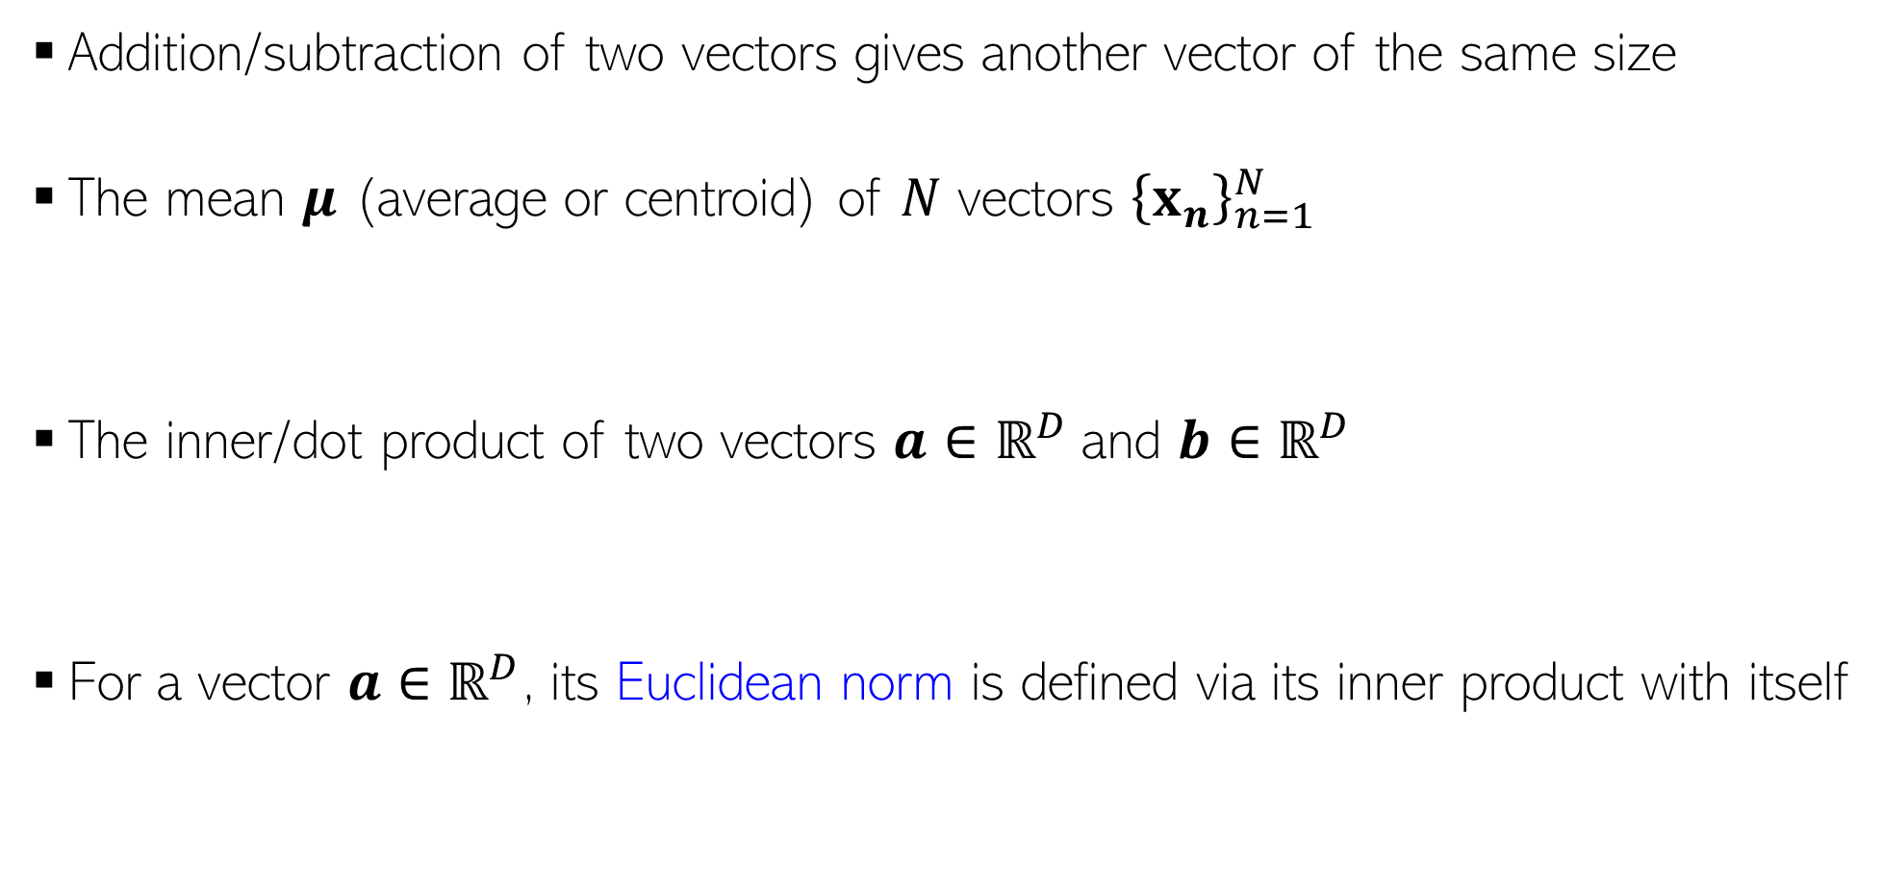
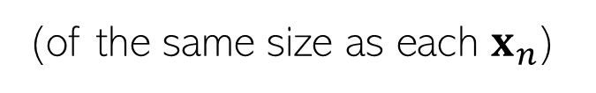
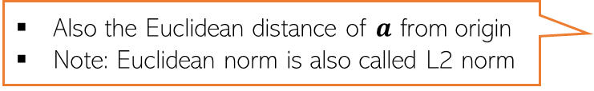
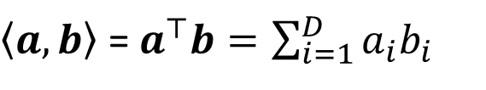
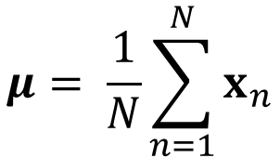
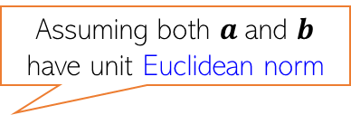
Some Basic Operations on Vectors
Addition/subtraction of two vectors gives another vector of the same size
The mean $μ$ (average or centroid) of $N$ vectors ${\left\{x_{n}\right\}}_{n=1}^{N}$
The inner/dot product of two vectors $a$ $∈ℝ^{D}$and $b$ $∈ℝ^{D}$
For a vector $a$ $∈ℝ^{D}$, its Euclidean norm is defined via its inner product with itself
$$μ= \frac{1}{N}\sum_{n=1}^{N}{x_{n}}$$
(of the same size as each $x_{n}$)
Assuming both $a$and $b$ have unit Euclidean norm
$\left\langle a,b\right\rangle$ = $a^{⊤}b=\sum_{i=1}^{D}{a_{i}b_{i}}$
(a real-valued number denoting how “similar” $a$and $b$are)
${\left\|a\right\|}_{2}=$ $\sqrt{a^{⊤}a}=$ $\sqrt{\sum_{i=1}^{d}{a_{i}^{2}}}$
Also the Euclidean distance of $a$ from origin
Note: Euclidean norm is also called L2 norm

Slide 22
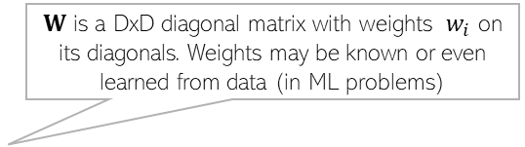
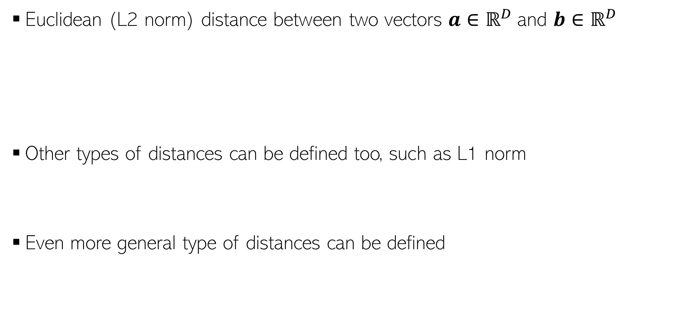
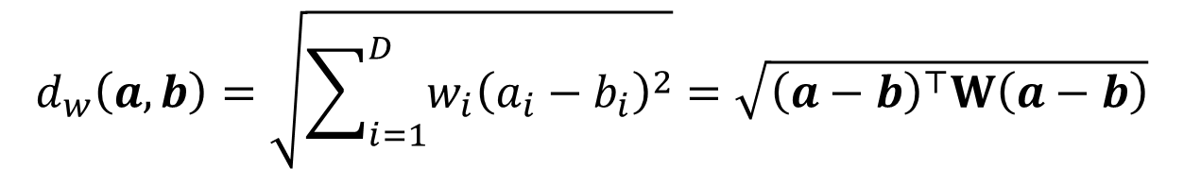
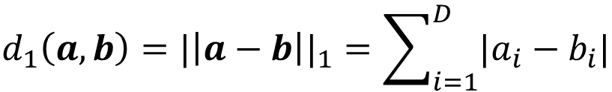
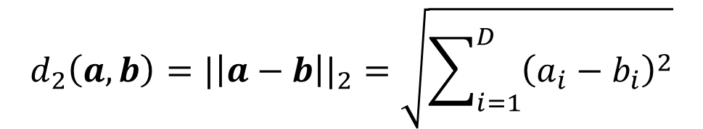
Computing Distances
Euclidean (L2 norm) distance between two vectors $a$ $∈ℝ^{D}$and $b$ $∈ℝ^{D}$
Other types of distances can be defined too, such as L1 norm
Even more general type of distances can be defined
$$d_{2}\left(a,b\right)={|\left|a−b\right||}_{2}=\sqrt{\sum_{i=1}^{D}{{\left(a_{i}−b_{i}\right)}^{2}}}$$
Another expression in terms of inner products of individual vectors
$$=\sqrt{{\left(a−b\right)}^{⊤}\left(a−b\right)}=\sqrt{a^{⊤}a+b^{⊤}b−2a^{⊤}b}$$
$$d_{1}\left(a,b\right)={|\left|a−b\right||}_{1}=\sum_{i=1}^{D}{|a_{i}−b_{i}|}$$
$W$ is a DxD diagonal matrix with weights $w_{i}$ on its diagonals. Weights may be known or even learned from data (in ML problems)
$$d_{w}\left(a,b\right)=\sqrt{\sum_{i=1}^{D}{{w_{i}\left(a_{i}−b_{i}\right)}^{2}}}=\sqrt{{\left(a−b\right)}^{⊤}W\left(a−b\right)}$$

Slide 23


Computing Similarities
Can also define similarity between two vectors $a$ $∈ℝ^{D}$and $b$ $∈ℝ^{D}$
Basically, opposite of distance
For defining similarity, can use any function that gives
High value when $a$ and $b$ are close/similar
Small value when $a$ and $b$ are far/dissimilar
Some examples
Dot product or cosine similarity
Kernel/similarity functions, such as the RBF (“radial basis function” or “Gaussian”) kernel
Kernel functions like this provide a “nonlinear” similarity function unlike the standard dot product which is a linear similarity function (more on this later)
$γ$ is called the bandwidth hyperparameter of this kernel function
$$k\left(a,b\right)= exp\left(−γ{\left\|a−b\right\|}^{2}\right)$$

Slide 24
Our First Supervised Learner

Slide 25



Prelude: A Very Primitive Classifier
The idea also applies to multi-class classification: Use one image per class, and predict label based on the distances of the test image from all such images
Consider a binary classification problem – cat vs dog
Assume training data with just 2 images – one and one
Given a new test image (cat/dog), how do we predict its label?
A simple idea: Predict using its distance from each of the 2 training images
d( , ) < d( , ) ? Predict cat else dog
Test
image
Test
image
Wait. Is it ML? Seems to be like just a simple “rule”. Where is the “learning” part in this?
Some possibilities: Use a feature learning/selection algorithm to extract features, and use a weighted Euclidean distance where you learn the $w_{i}$’s matrix (instead of using a predefined $w_{i}$’s), using “distance metric learning” techniques
Excellent question! Glad you asked!
Even this simple model can be learned. For example, for the feature extraction/selection part and/or for the distance computation part

Slide 26
Improving Our Primitive Classifier
Just one input per class may not sufficiently capture variations in a class
A natural improvement can be by using more inputs per class
We will consider two approaches to do this
Learning with Prototypes (LwP), also called “Nearest Class Mean” (NCM)
Nearest Neighbors (NN – not “neural networks”, at least not for now ☺)
Both LwP and NN will use multiple inputs per class but in different ways
“cat”
“dog”
“cat”
“dog”
“cat”
“dog”

Slide 27



Learning with Prototypes (LwP)
Basic idea: Represent each class by a “prototype” vector
Class Prototype: The “mean” or “average” of inputs from that class
Predict label of each test input based on its distances from the class prototypes
Predicted label will be the class that is the closest to the test input
How we compute distances can have an effect on the accuracy of this model (may need to try Euclidean, weight Euclidean, or something else)
Averages (prototypes) of each of the handwritten digits 1-9
Pic from: https://www.reddit.com/r/dataisbeautiful/comments/3wgbv9/average_handwritten_digit_oc/

Slide 28






Learning with Prototypes (LwP): An Illustration
Suppose the task is binary classification (two classes assumed pos and neg)
Training data: $N$ labelled examples ${\{\left(x_{n},y_{n}\right)\}}_{n=1}^{N}$,${ x}_{n}∈ℝ^{D}$, ${ y}_{n} ∈\{−1,+1\}$
Assume $N_{+}$ example from positive class, $N_{−}$ examples from negative class
Assume green is positive and red is negative
$$μ_{−}= \frac{1}{N_{−}}\sum_{y_{n}=−1}{x_{n}}$$
$$μ_{+}= \frac{1}{N_{+}}\sum_{y_{n}=+1}{x_{n}}$$
$$μ_{−}$$
$$μ_{+}$$
LwP straightforwardly generalizes to more than 2 classes as well (multi-class classification) – K prototypes for K classes
For LwP, the prototype vectors ($μ_{+}$and $μ_{−}$here) define the “model”
Test example
Test example

Slide 29



LwP: The Prediction Rule, Mathematically
What does the prediction rule for LwP look like mathematically?
Assume we are using Euclidean distances here
$${\left|\left|μ_{−}−x\right|\right|}^{2}={\left|\left|μ_{−}\right|\right|}^{2}+{\left|\left|x\right|\right|}^{2}−2\left\langle μ_{−},x\right\rangle$$
$$μ_{−}$$
$$μ_{+}$$
$${\left|\left|μ_{+}−x\right|\right|}^{2}={\left|\left|μ_{+}\right|\right|}^{2}+{\left|\left|x\right|\right|}^{2}−2\left\langle μ_{+},x\right\rangle$$
Test example $x$
Prediction Rule: Predict label as +1 if $f\left(x\right)={\left|\left|μ_{−}−x\right|\right|}^{2}$ $−$ ${\left|\left|μ_{+}−x\right|\right|}^{2}>0$ otherwise -1

Slide 30


LwP: The Prediction Rule, Mathematically
Let’s expand the prediction rule expression a bit more
Thus LwP with Euclidean distance is equivalent to a linear model with
Weight vector $w=$2($μ_{+}−μ_{−})$
Bias term $b={\left|\left|μ_{−}\right|\right|}^{2} −{\left|\left|μ_{+}\right|\right|}^{2}$
Prediction rule therefore is: Predict +1 if $\left\langle w,x\right\rangle +b$ > 0, else predict -1
$f\left(x\right)={\left|\left|μ_{−}−x\right|\right|}^{2}$ $−$ ${\left|\left|μ_{+}−x\right|\right|}^{2}$
$= {\left|\left|μ_{−}\right|\right|}^{2}+{\left|\left|x\right|\right|}^{2}−2\left\langle μ_{−},x\right\rangle −{\left|\left|μ_{+}\right|\right|}^{2}−{\left|\left|x\right|\right|}^{2}+2\left\langle μ_{+},x\right\rangle$
$= 2\left\langle μ_{+}−μ_{−},x\right\rangle$ + ${\left|\left|μ_{−}\right|\right|}^{2} −{\left|\left|μ_{+}\right|\right|}^{2}$
$= \left\langle w,x\right\rangle +b$
Will look at linear models more formally and in more detail later

Slide 31



LwP: Some Failure Cases
Here is a case where LwP with Euclidean distance may not work well
In general, if classes are not equisized and spherical, LwP with Euclidean distance will usually not work well. Can you think of how to fix this issue?
Can use feature scaling or use Mahalanobis distance to handle such cases (will discuss this in the next lecture)
$$μ_{−}$$
$$μ_{+}$$
Test example $x$

Slide 32
LwP: Some Key Aspects
Very simple, interpretable, and lightweight model
Just requires computing and storing the class prototype vectors
Works with any number of classes (thus for multi-class classification as well)
Can be generalized in various ways to improve it further, e.g.,
Modeling each class by a probability distribution rather than just a prototype vector
Using distances other than the standard Euclidean distance (e.g., Mahalanobis)
With a learned distance function, can work very well even with very few examples from each class (used in some “few-shot learning” models nowadays – if interested, please refer to “Prototypical Networks for Few-shot Learning”)
How well LwP works depends crucially on the way we compute distances

